Slide 1
DUBAI HOUSE PRICING

Slide 2
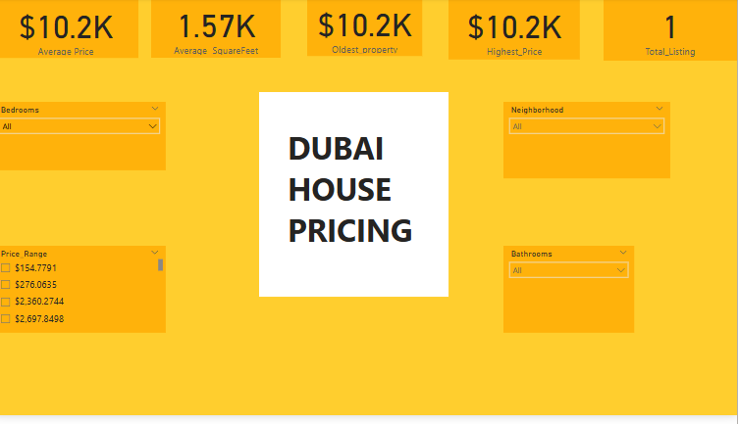

Slide 3
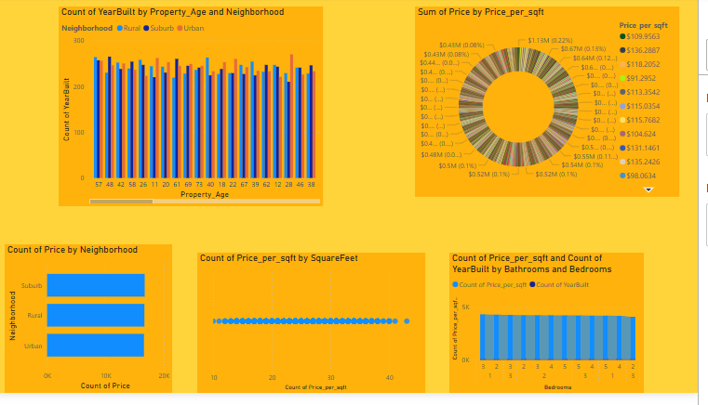

Slide 4
The housing price dataset offers a detailed overview of residential property listings, capturing vital information such as price, square footage, number of bedrooms and bathrooms, neighborhood, and construction year. To ensure the reliability and accuracy of analysis, the dataset underwent essential data cleaning and transformation steps using Power BI
In the cleaning phase, rows with invalid entries — such as zero or negative values in Price, SquareFeet, or YearBuilt before 1800 — were removed. Duplicate records were eliminated, and data types were standardized. Numerical values like Price, SquareFeet, Bedrooms, and Bathrooms were cast as numeric types, while categorical attributes such as Neighborhood and ListingCategory were treated as text for grouping and segmentation.
New calculated columns were created to enrich the dataset. price_per_sqft was computed by dividing the property’s price by its square footage, allowing users to compare pricing regardless of property size.

Slide 5
A property_age column, derived from the year 2025 minus the YearBuilt value, was added to give insight into the relative age of each home. To segment the market, a listing_category column was created using DAX, classifying listings into "Budget", "Mid-Range", and "High-End" based on 33rd and 66th percentiles of price distribution. A separate column for Price Range was also created to support intuitive filtering.
Several key metrics were visualized using KPI cards in Power BI. These include Total Listings, Average Price, Average Price per Square Foot, Most Expensive Property, and Oldest Property. These indicators provide a high-level snapshot of the market.
To explore categorical comparisons, a clustered bar chart was used to display the count of listings across neighborhoods, broken down by listing category. This visual effectively reveals the distribution of budget and high-end listings by location. A pie chart highlights the overall distribution of property categories, showing how the market is divided among Budget, Mid-Range, and High-End homes.

Slide 6
A scatter plot was also implemented to study the relationship between square footage and price, with data points colored by listing category. This visual helps detect pricing trends, clusters, and anomalies.
In conclusion,
The housing dataset, enhanced with calculated fields and visualized through intuitive charts, provides valuable insights into real estate pricing, neighborhood trends, and market segmentation. It serves as a powerful tool for analysts, investors, and decision-makers in the property domain.

